Slide 1
Boolean Arithmetic
Elements of Computing Systems, Nisan & Schocken, MIT Press www.idc.ac.il/tecs
Usage and Copyright Notice:
Copyright 2005 © Noam Nisan and Shimon Schocken
This presentation contains lecture materials that accompany the textbook “The Elements of Computing Systems” by Noam Nisan & Shimon Schocken, MIT Press, 2005.
We provide both PPT and PDF versions.
The book web site, www.idc.ac.il/tecs , features 13 such presentations, one for each book chapter. Each presentation is designed to support about 3 hours of classroom or self-study instruction.
You are welcome to use or edit this presentation as you see fit for instructional and non-commercial purposes.
If you use our materials, we will appreciate it if you will include in them a reference to the book’s web site.
If you have any questions or comments, you can reach us at tecs.ta@gmail.com

Slide 2
Counting systems
quantity decimal binary 3-bit register
0 0 000
 1 1 001
 2 10 010
 3 11 011
 4 100 100
 5 101 101
 6 110 110
 7 111 111
 8 1000 overflow
 9 1001 overflow
 10 1010 overflow

Slide 3
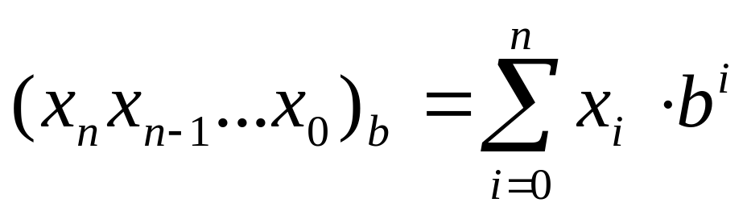
Rationale

Slide 4
Binary addition
Assuming a 4-bit system:
0 0 0 1
1 0 0 1
0 1 0 1
0 1 1 1 0
1 1 1 1
1 0 1 1
0 1 1 1
1 0 0 1 0
no overflow
overflow
Algorithm: exactly the same as in decimal addition
Overflow (MSB carry) has to be dealt with.

Slide 5
Representing negative numbers (4-bit system)
0 0000
1 0001 1111 -1
2 0010 1110 -2
3 0011 1101 -3
4 0100 1100 -4
5 0101 1011 -5
6 0110 1010 -6
7 0111 1001 -7
1000 -8
The codes of all positive numbers
begin with a “0”
The codes of all negative numbers
begin with a “1“
To convert a number:
leave all trailing 0’s and first 1 intact,
and flip all the remaining bits
Example: 2 - 5 = 2 + (-5) = 0 0 1 0
+ 1 0 1 1
1 1 0 1 = -3

Slide 6
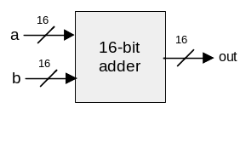
Building an Adder chip
Adder: a chip designed to add two integers
Proposed implementation:
  Half adder: designed to add 2 bits
  Full adder: designed to add 3 bits
  Adder: designed to add two n-bit numbers.

Slide 7
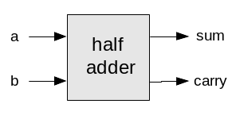
Half adder (designed to add 2 bits)
a b carry sum
0 0 0 0
0 1 0 1
1 0 0 1
1 1 1 0
Implementation: based on two gates that you’ve seen before.

Slide 8
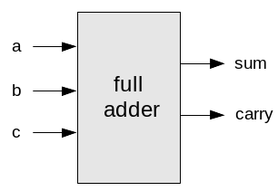
Full adder (designed to add 3 bits)
a b c carry sum
0 0 0 0 0
0 0 1 0 1
0 1 0 0 1
0 1 1 1 0
1 0 0 0 1
1 0 1 1 0
1 1 0 1 0
1 1 1 1 1
Implementation: can be based on half-adder gates.

Slide 9
n-bit Adder
... 1 0 1 1 a
… 0 0 1 0 b
… 1 1 0 1 out
+
Implementation: array of full-adder gates.

Slide 10
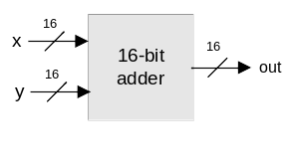

The ALU (of the Hack platform)
out(x, y, control bits) =
x+y, x-y, y–x,
0, 1, -1,
x, y, -x, -y,
x!, y!,
x+1, y+1, x-1, y-1,
x&y, x|y

Slide 11
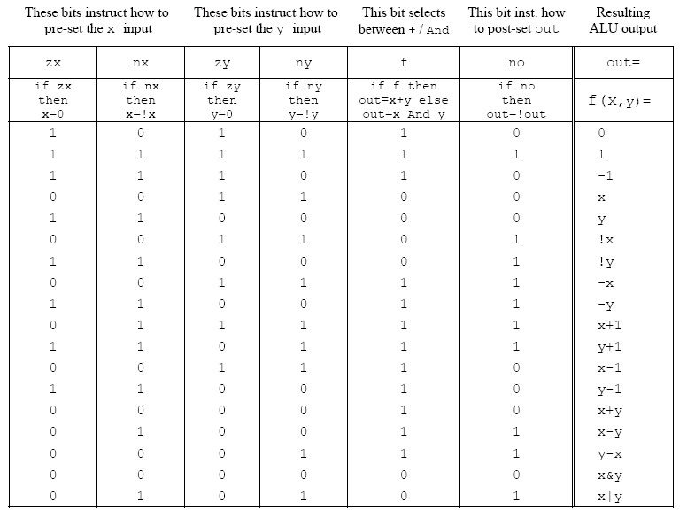
ALU logic (Hack platform)
Implementation: build a logic gate architecture
that “reads” each control bit and does what
the table specifies: if zx=1 then set x to 0, etc.

Slide 12
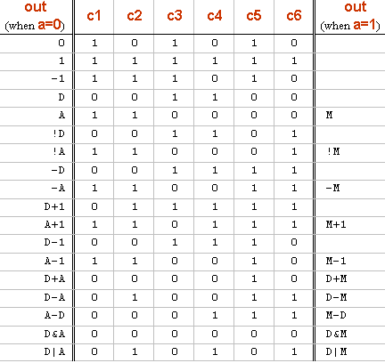
The ALU in the CPU context (Hack platform)
c1,c2, … ,c6
D register
D
a
out
A
ALU
A register
A/M
Mux
RAM
(selected register)
M

Slide 13
Perspective
Combinational logic
Our adder design is very basic: no parallelism
It pays to optimize adders
Our ALU is also very basic: no multiplication / division
Where is the seat of advanced math operations?
a typical hardware/software tradeoff.

Slide 14
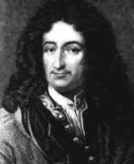
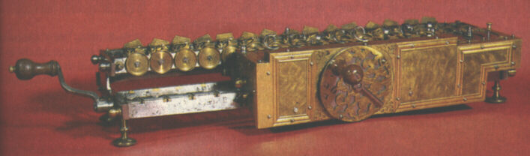
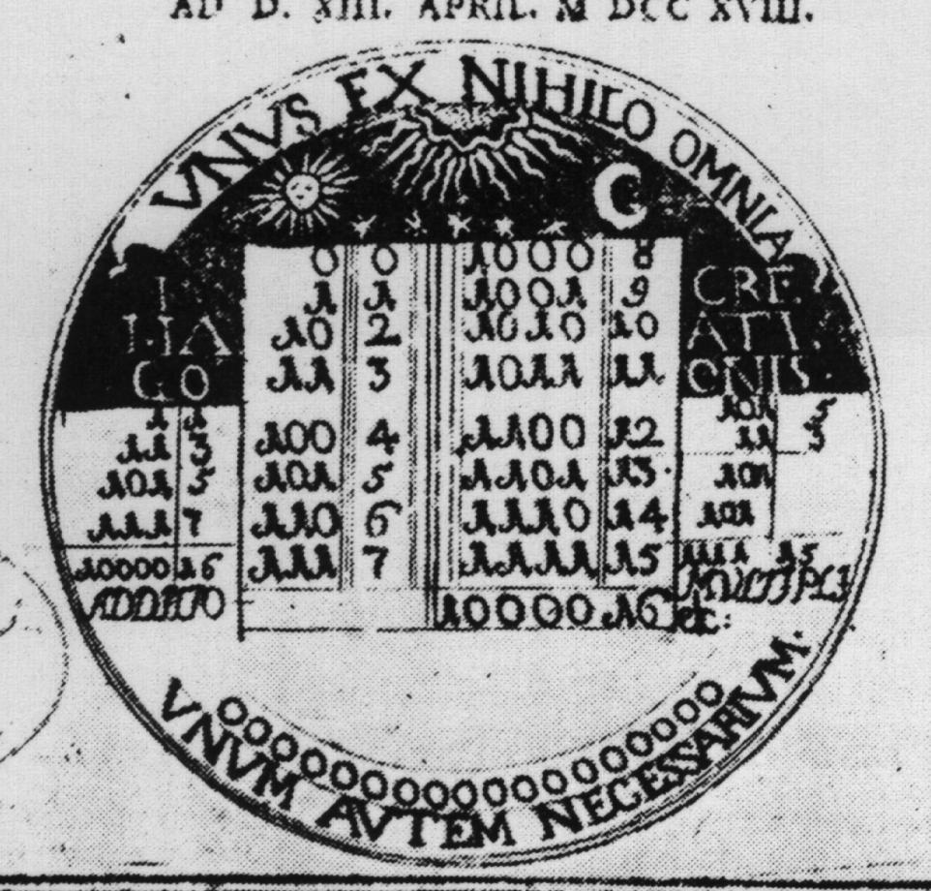
Historical note: Leibnitz (1646-1716)
“The binary system may be used in place of the decimal system; express all numbers by unity and by nothing”
1679: built a mechanical calculator (+, -, *, /)
CHALLENGE: “All who are occupied with the reading or writing of scientific literature have assuredly very often felt the want of a common scientific language, and regretted the great loss of time and trouble caused by the multiplicity of languages employed in scientific literature:
SOLUTION: “Characteristica Universalis”: a universal, formal, language of reasoning
The dream’s end: Turing and Goedl in 1930’s.
Leibniz’s medallion
for the Duke of Brunswick

